Slide 1
Course code : CSE3009 Course title : No SQL Data Bases Module : 2 Topic : 4
Document Data Model

Slide 2
Objectives
This session will give the knowledge about
Document Data Model

Slide 3
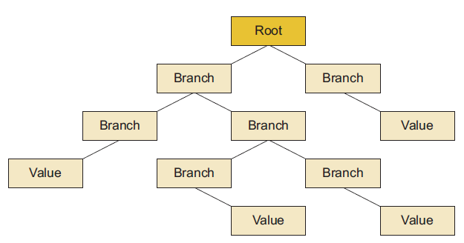
Document Data Model
Document stores use a tree structure that begins with a root node, and have sub branches that can also contain sub-branches.
The actual data values are usually stored at the leaf levels of a tree.

Slide 4
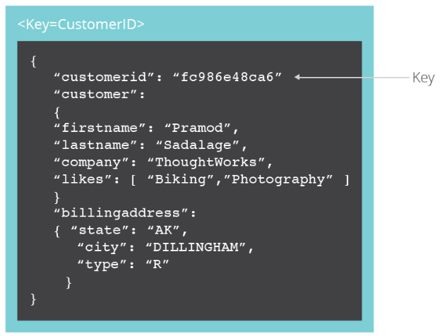
Document Data Model
Documents are the main concept in document databases.
The database stores and retrieves documents, which can be XML, JSON, BSON, and so on.
These documents are self-describing, hierarchical tree data structures which can consist of maps, collections, and scalar values.

Slide 5
Document Data Model
The documents stored are similar to key-value data store but do not have to be exactly the same.
Document-Oriented NoSQL DB stores and retrieves data as a key value pair but the value part is stored as a document.
The document is stored in JSON or XML formats.
Each document contains semi-structured data that can be queried against using various query and analytics tools of the DBMS

Slide 6
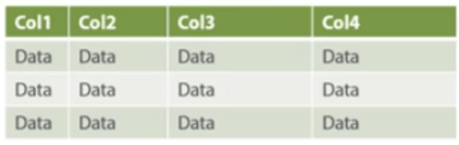
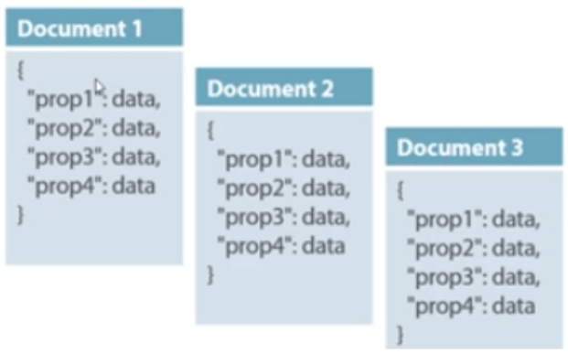
Document Data Model VS RDBMS
MongoDB Example
>db.mycol.find(
{ $and: [
{key1: value1}, {key2:value2}
] } )
> db.cse.find({ $and: [{sid: {$gt:500}},{mark:{$gte:70}} ] } )

Slide 7
Document collections
Most document stores group documents together in collections. These collections look like a directory structure OS file systems.
Document collections can be used in many ways to manage large document stores.
Document collections can serve as ways to
navigate document hierarchies,
logically group similar documents, and
store business rules such as permissions, indexes, and triggers.
Collections can contain other collections and trees can contain subtrees.

Slide 8
Document collections
XML Document Example
<artist>
<artistname>IronMaiden</<artistname>
<albums>
<album>
<albumname>The Book of Souls
</albumname>
<datereleased>2015</datereleased>
<genre>Hard Rock</genre>
</album>
</artist>
JSON Document Example
{
'_id' : 1,
'artistName' : { 'Iron Maiden' },
'albums' : [
{
'albumname' : 'The Book of Souls',
'datereleased' : 2015,
'genre' : 'Hard Rock'
}
]
}

Slide 9
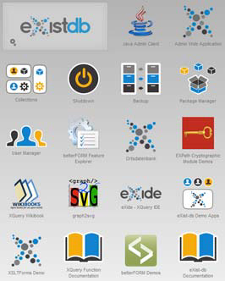
Application collections
In some situations, the collection in a document store is used as a container for a web application package.
This packaging format, called a xar file, is similar to a Java JAR file or a WAR file on Java web servers.
Packaged applications can contain scripts as well as data. They’re loaded into the document store and use packaging tools (scripts) to reload the data.
These packaging features make document stores more versatile, expanding their functionality to become application servers as well as document stores.

Slide 10
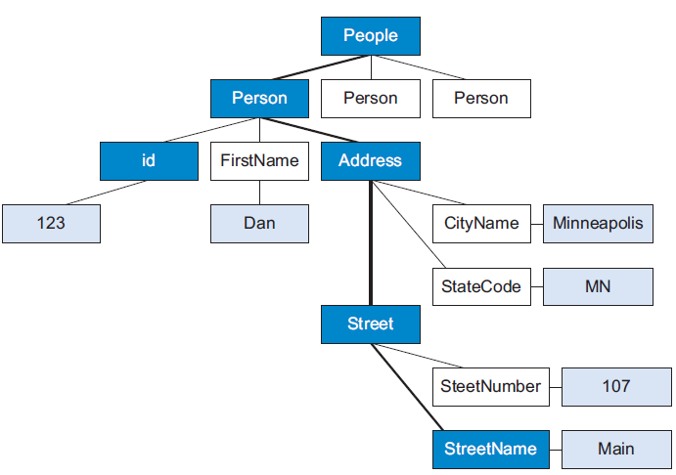
Document Data Model – Data Retrieval
How a document path is used like a key to get the value out of a specific cell in a document?
In this example, the path to the street name is
People/Person[id='123']/Address/Street/StreetName/text().

Slide 11
Document Store APIs
Each document store has an API or query language that specifies the path or path expression to any node or group of nodes.
For example, to select the seventh person in a list of people, you might specify this query: Person[7].
Next to look in the Address section, the full path name to the street name is the following: People/Person[id='123']/Address/Street/ StreetName/text().
Document databases such as MongoDB provide a rich query language and constructs such as database, indexes etc allowing for easier transition from relational databases.

Slide 12
Document store implementations
A document store can come in many varieties.
Some are based on simple serialized object trees and some are more complex, containing content that might be found in web pages with text markup.
Simpler document structures are often associated with serialized objects and may use the JavaScript Object Notation (JSON) format.
In our context we refer to
Serialized object stores - JSON data stores as and
Native format document stores - support complex content as true document stores with XML.

Slide 13
Benefit of the Document Model over Key-Value Stores
One benefit that document store databases have over key-value databases, is that you can query the data itself.
You can query against the structure of the document, as well as the elements within that structure. Therefore, you can return only those parts of the document that you require.
With a key-value database, you get the whole value – no matter how big (and seemingly structured) it might be. You can’t query within the value.

Slide 14
Document Store suitable for
Document store databases are preferable for:
Web Applications
User Generated Content
Catalog Data
Gaming
Networking/computing
E-commerce platforms
Content management systems
Analytics platforms
Blogging platforms

Slide 15
Document Store Not suitable for
The document type is mostly used for CMS systems, blogging platforms, real-time analytics & e-commerce applications.
Document store NoSQL databases are not the right choice if you have to run complex search queries or if your application requires complex multiple operation transactions.
Here are examples of some of the leading document store DBMSs.
MongoDB, DocumentDB, CouchDB, MarkLogic, OrientDB

Slide 16
Case study: ad server with MongoDB
Do you ever wonder how those banner ads show up on the web pages you browse or how they really seem to target the things you like or are interested in?
It’s done with ad serving.
The original reason for MongoDB, was to create a service that would quickly send a banner ad to an area on a web page for millions of users at the same time.
MongoDB can be used in some of the following use cases:
Content management
Real-time operational intelligence
Product data management
User data management.

Slide 17
Summary
This session will give the knowledge about
Document Data Model

